Slide 1
Productivity software
By Niloufar Kashefi

Slide 2
Table of contents
01
02
03
Introduction
Productivity Software
Resources

Slide 3

01
Introduction

Slide 4
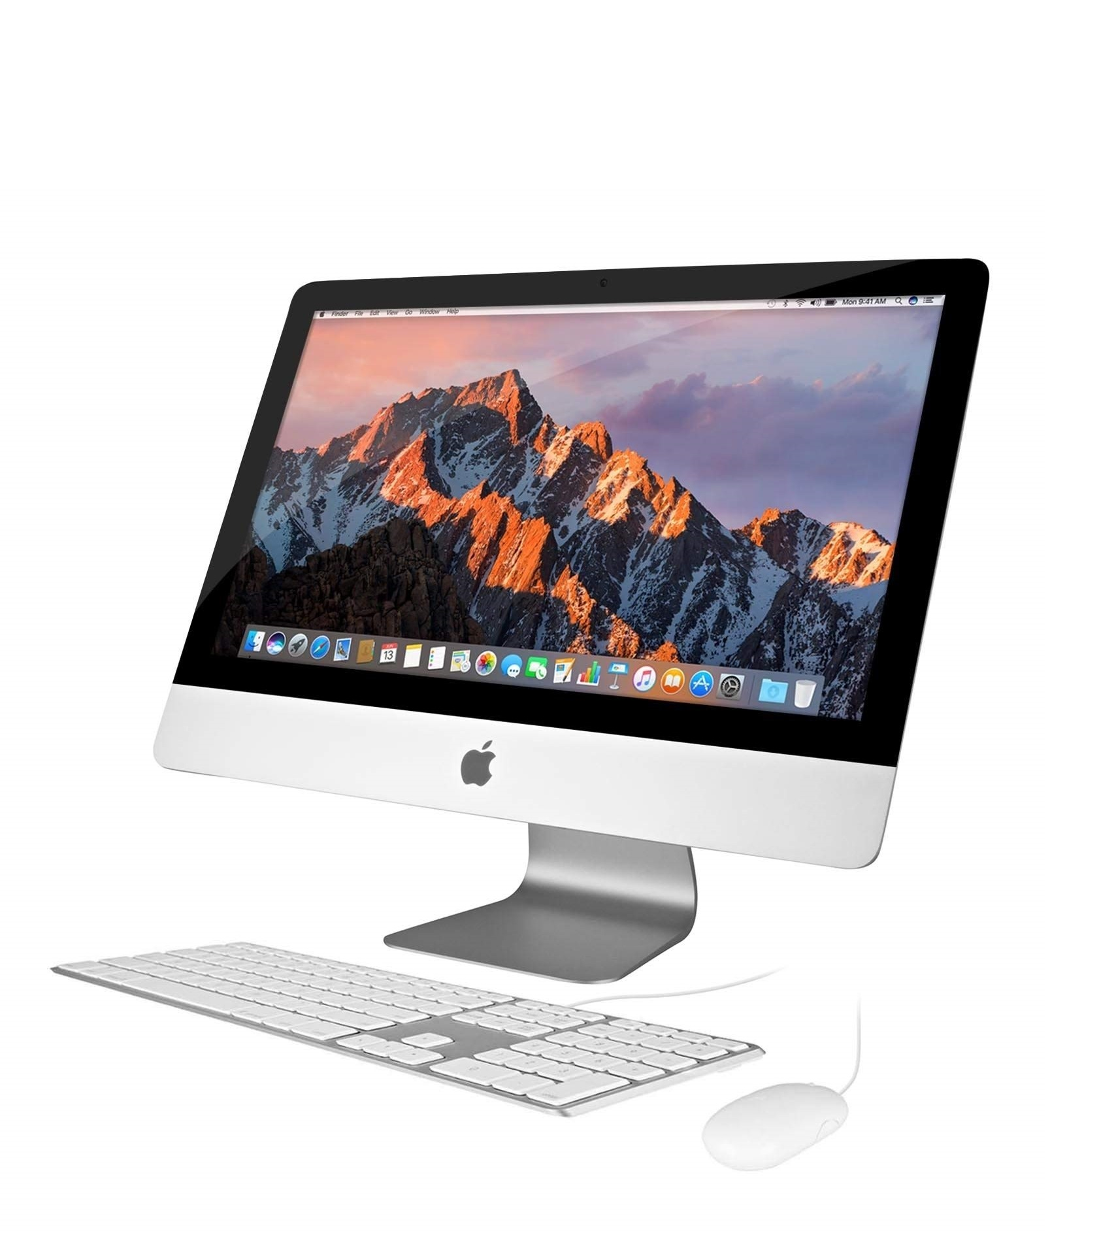
Productivity Software
Productivity software refers to a category of computer programs and applications designed to help users accomplish tasks more efficiently, typically in a work, study, or personal context. The main goal of productivity software is to improve performance, organization, and output quality by automating or simplifying routine tasks.

Slide 5

02
Productivity software

Slide 6
Productivity software categories:
Some common types of productivity software include:
Word Processing Software | (Microsoft Word, Google Docs) – for creating and editing text documents.
Spreadsheet Software | (Microsoft Excel, Google Sheets, Airtable) – for data organization, analysis, and calculation.
Presentation Software | (Microsoft PowerPoint, Canva) – for creating visual slideshows and presentations.
Database Management Systems | (Microsoft Access, MySQL frontends, Notation) – for storing and managing structured data.
Email and Communication Tools | (Microsoft Outlook, Gmail, Slack) – for managing messages and collaboration.
Project Management Tools | (Trello, Asana, Notion) – for organizing tasks, schedules, and teamwork.
Cloud Storage | (OneDrive, Google Drive,، Dropbox)
Business Intelligence & Analytics | (Power BI, Tableau)

Slide 7
Google Workspace
Microsoft office 365
Zoho Workspace
Docs, Sheets, Slides, Drive, etc.
SharePoint, Power BI, etc.
Cliq, WorkDrive, etc.

Slide 8
Google Workspace
Text, Spreadsheet, Presentation
Collaborate, Connection
Docs
Sheets
Slides
Meet
Chat
Email, Calender
Internal page, interanet
Gmail
Calender
Sites
Cloud storage, Share file
Data analysis, Dashboard
Drive
Looker studio

Slide 9
Microsoft 365 (Office 365)
Text, Spreadsheet, Presentation
Collaborate, Connection
Word
Excel
PowerPoint
Teams
Email, Calender
Internal page, interanet
Outlook
SharePoint
Cloud storage, Share file
Data analysis, Dashboard
OneDrive
Power BI

Slide 10

06
Resources

Slide 11
Resources
Become a programmer using these sites:
Iranian
https://faradars.org/
https://maktabkhooneh.org/
https://www.toplearn.com/
Foreign
https://www.youtube.com/
https://www.udemy.com/
https://www.coursera.org/
https://www.linkedin.com/

Slide 12

CREDITS: You are allowed to share this file

